Slide 1
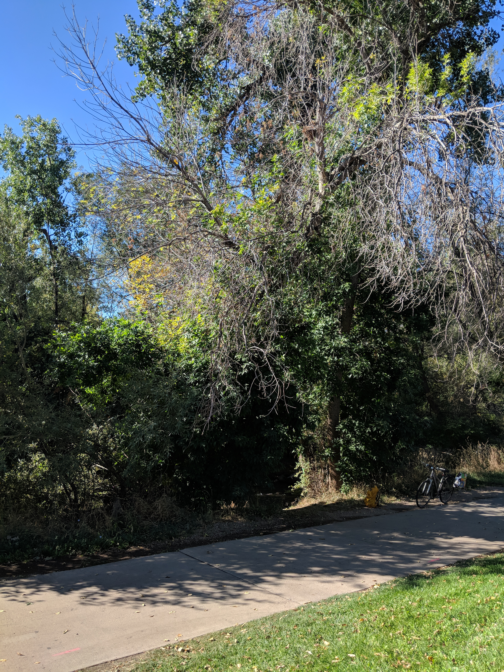
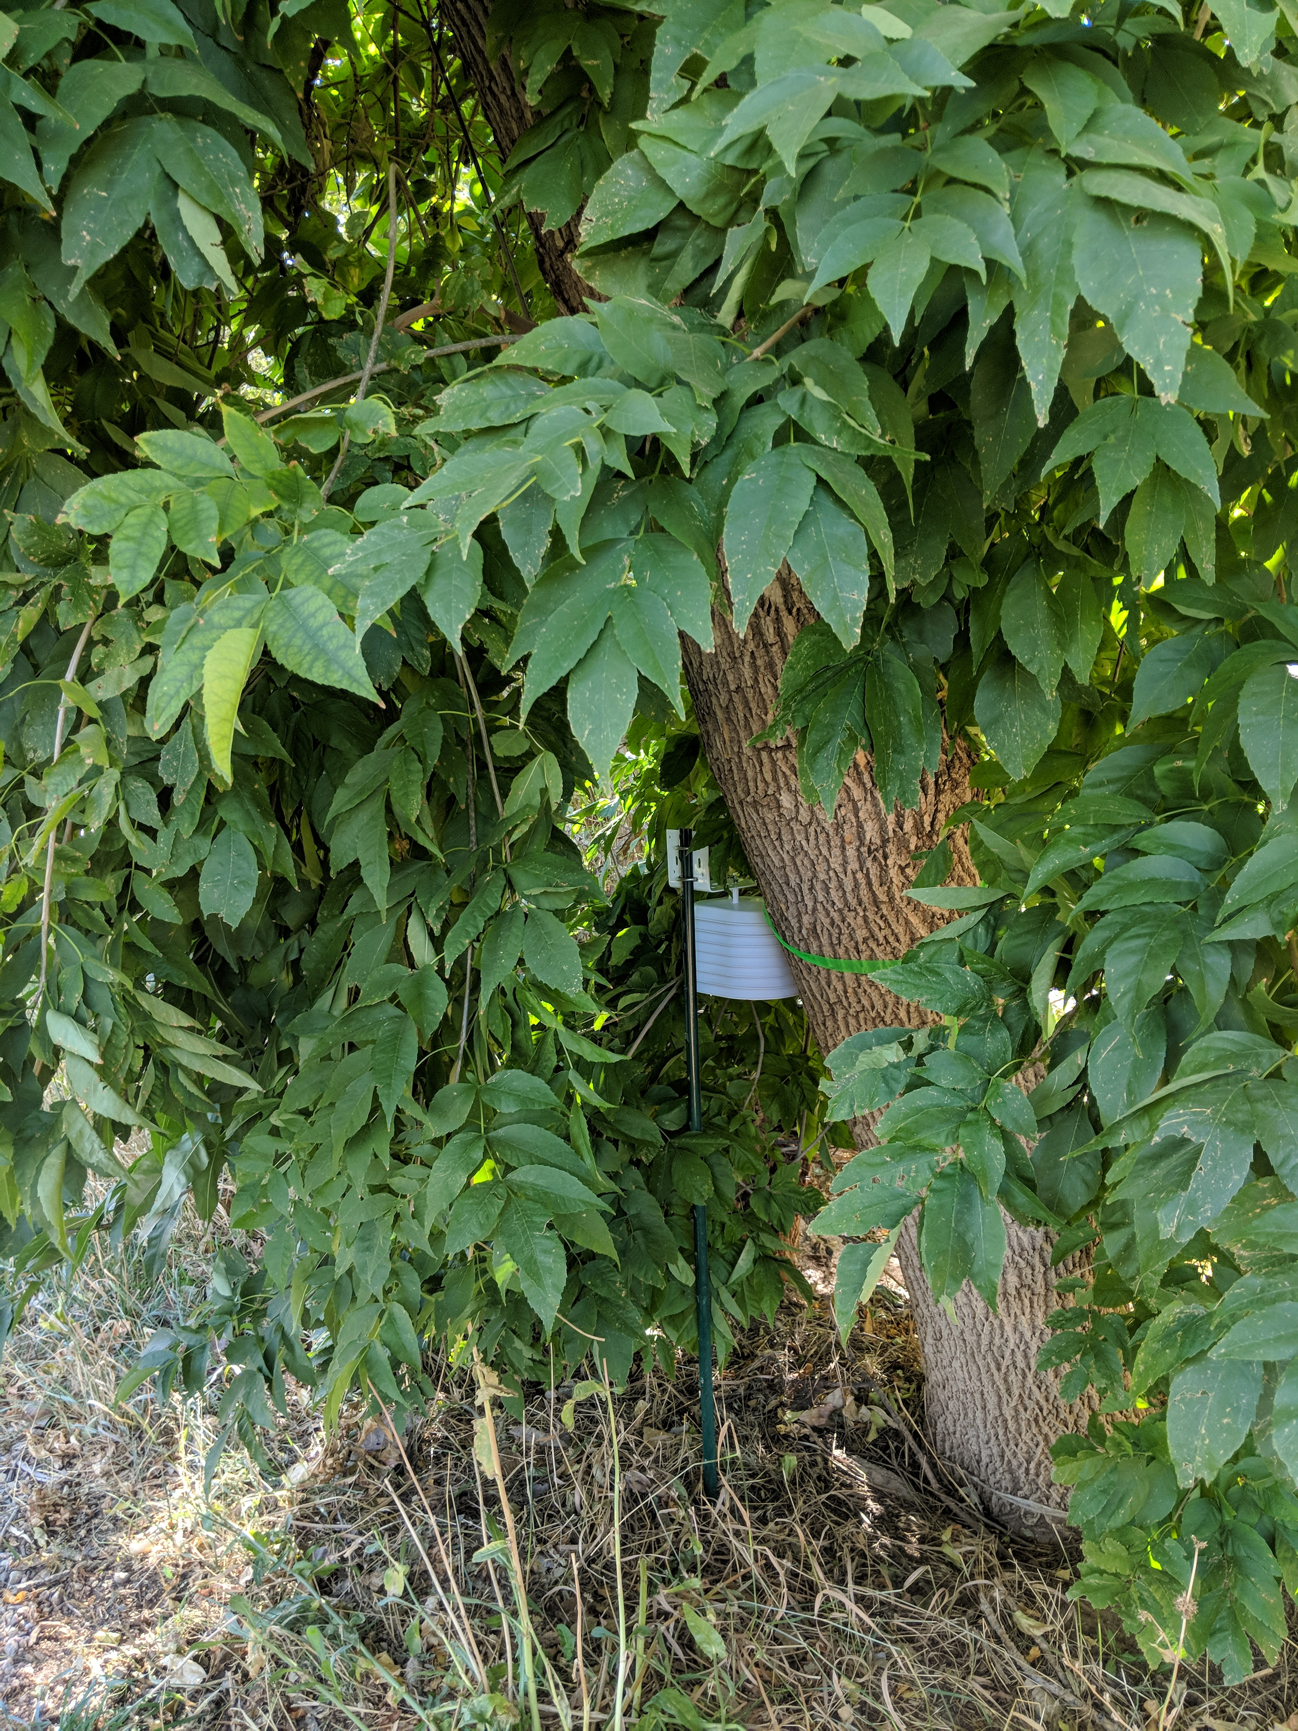
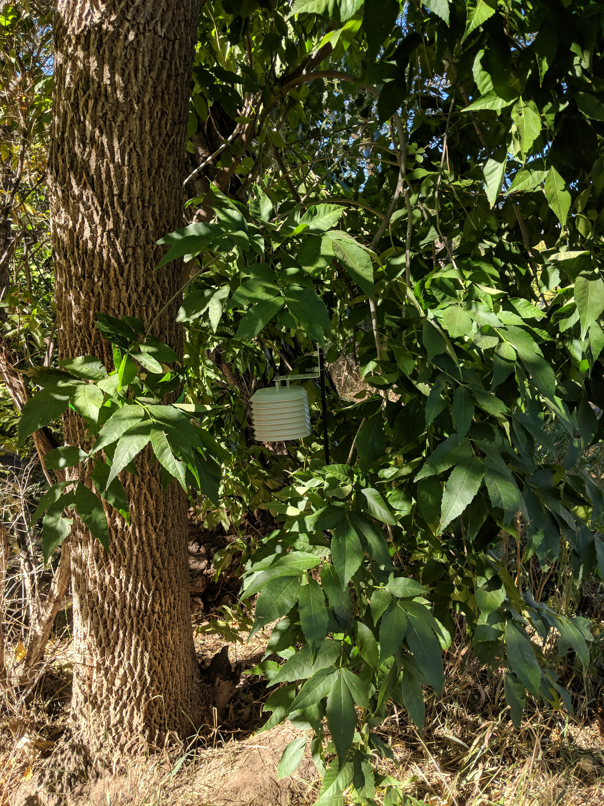
a)
c)
Treatment Tree 100e
Treatment Tree 101w
Treatment Tree 101w
Treatment Tree 100e
b)

Slide 2
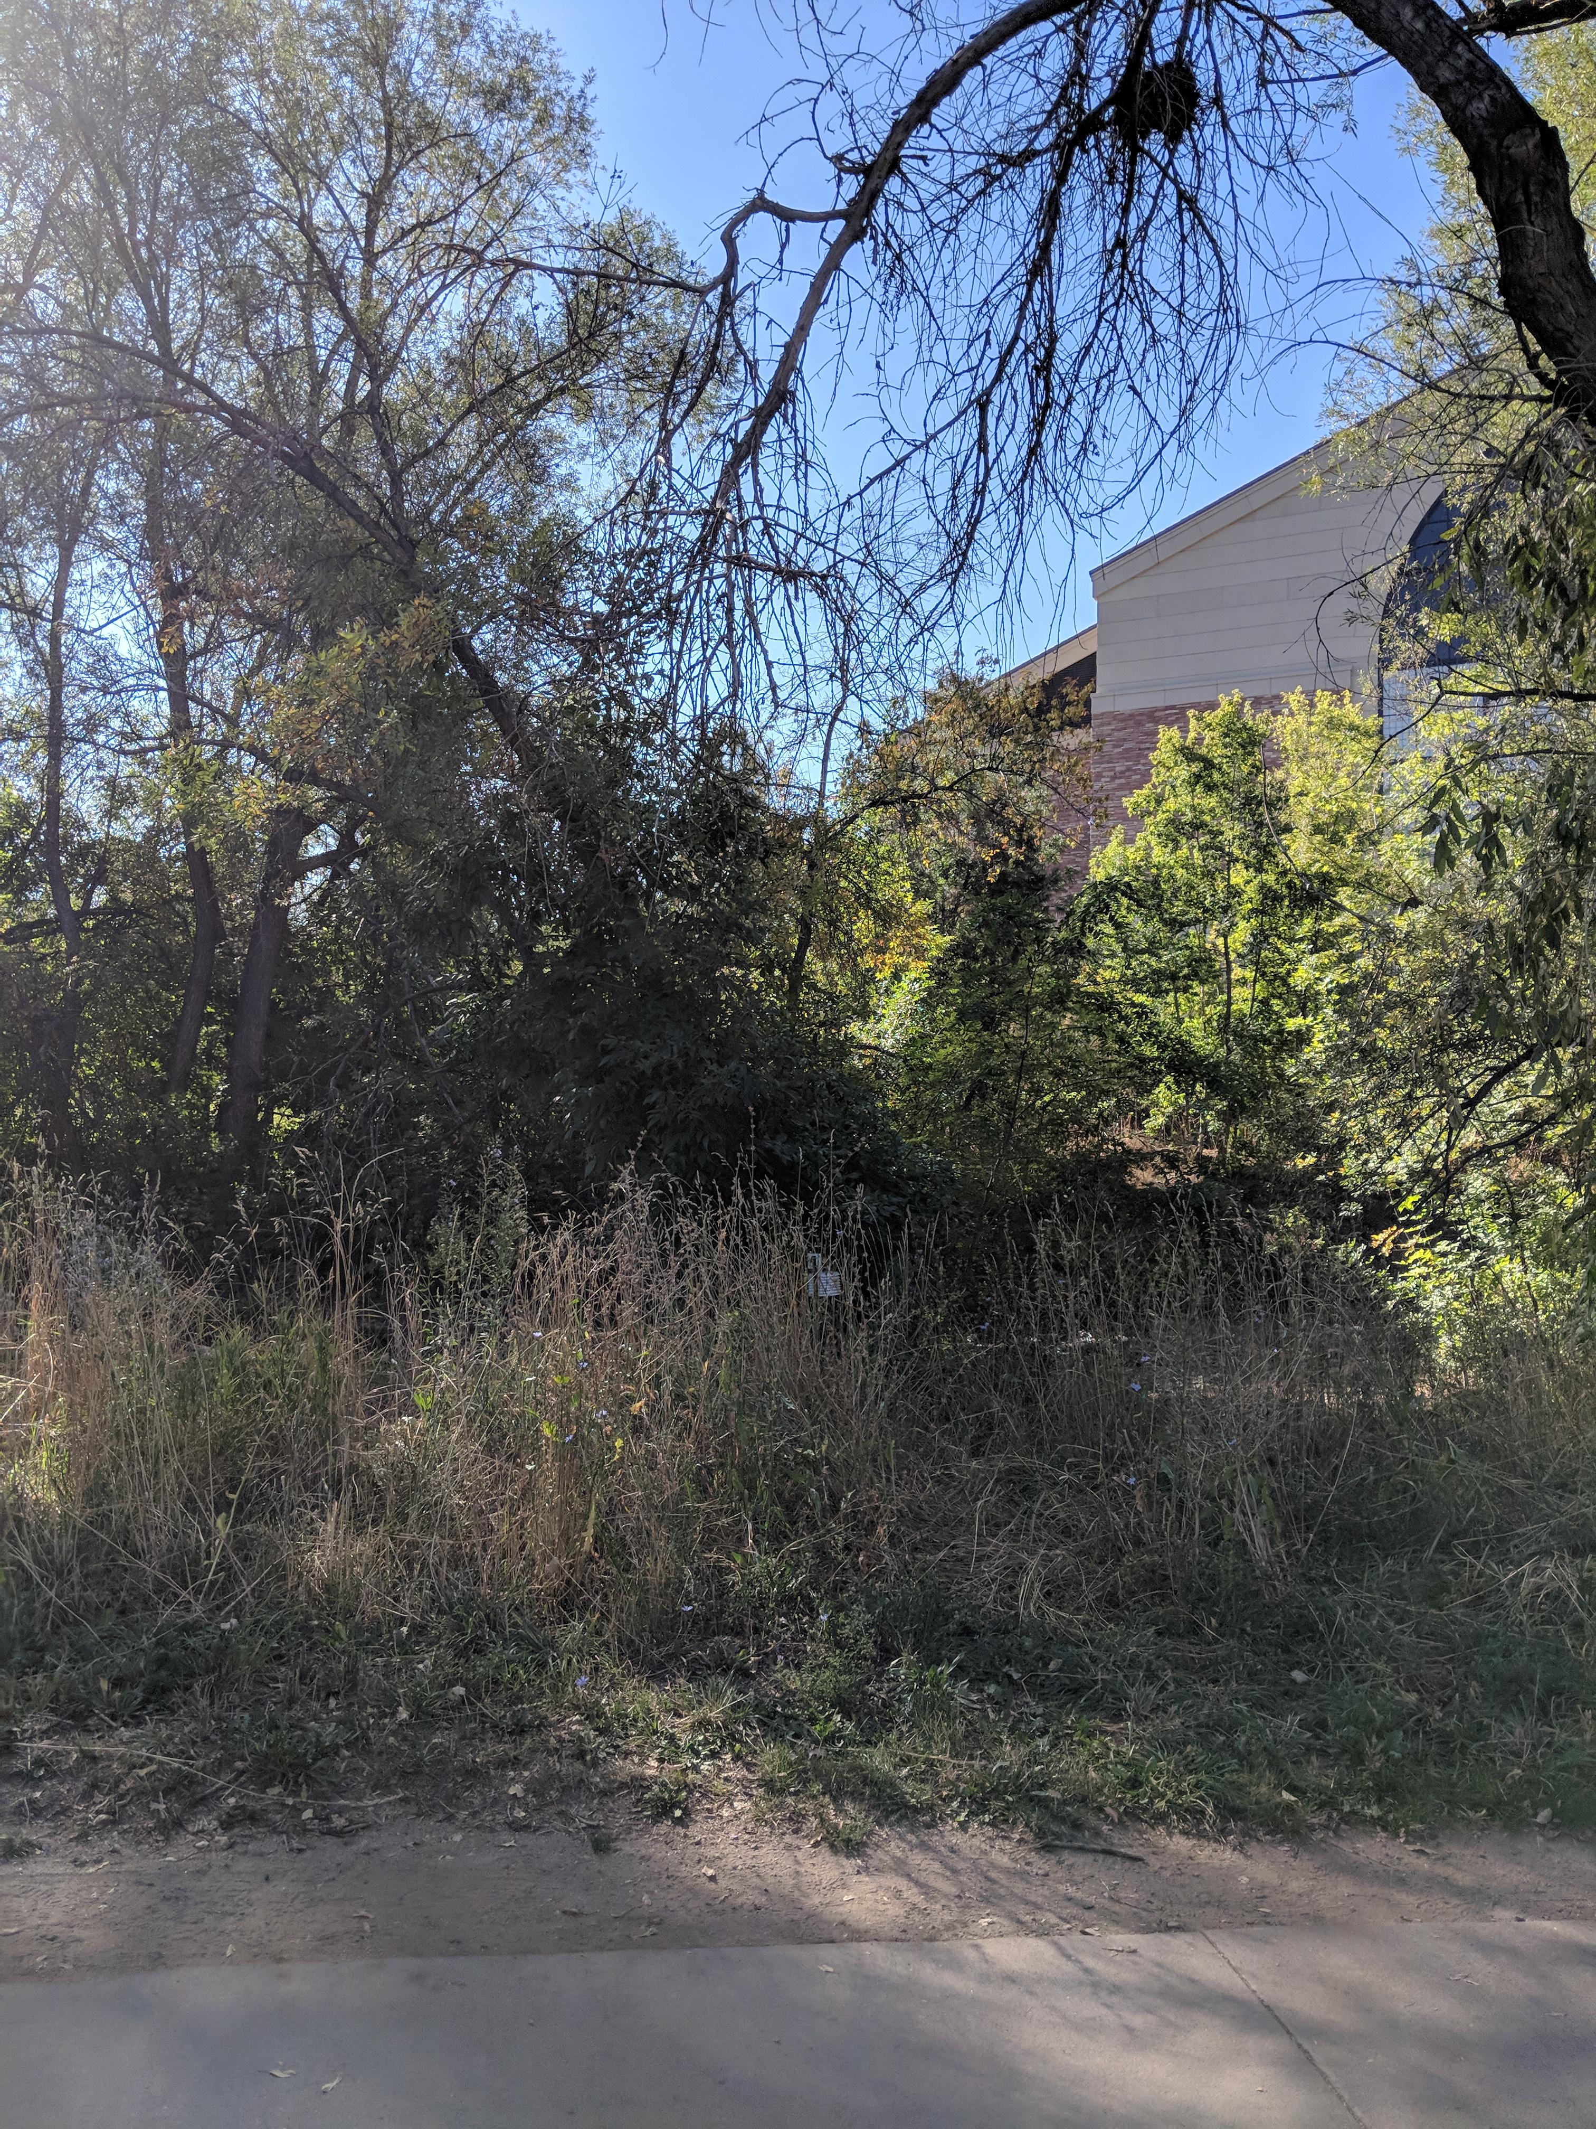
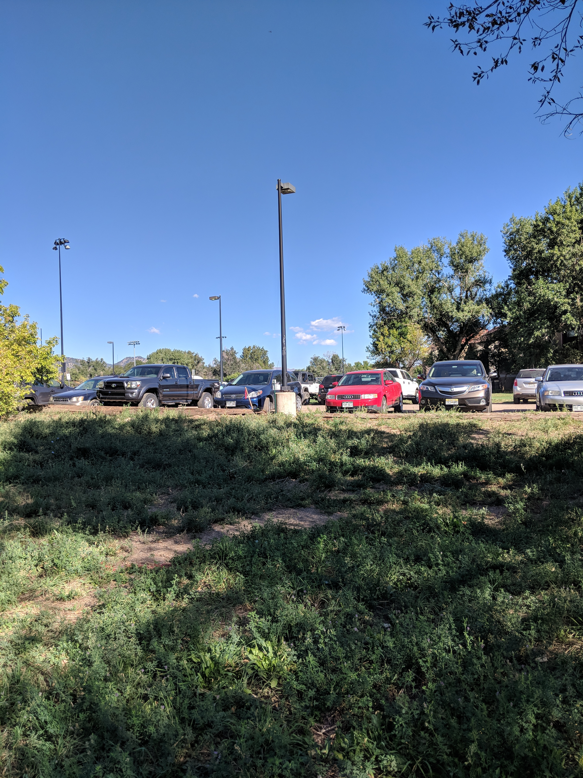
Control Tree 103 Site
Sun Control Site
a)
b)

